Slide 1
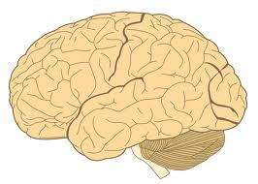
Ten Minutes About: Hemorrhagic Strokes
Kelly Wasielewski, RN, CRRN
MSN 621
Image taken from
google images

Slide 2
Hemorrhagic Strokes
Sally a 48 year old female was brought into the ER. Her family stated that before taking a nap she was complaining of a severe headache. She described it as the “worst headache of her life.” She now presents with a temperature of 99.4, a irregular heart rate of 58, Respirations of 32 and irregular, and a blood pressure of 215/74. She seems to comprehend, but when asked questions she jumbles her words and gets easily frustrated. She is unable to move her right arm and her right leg is weak. Her health history includes anxiety, diabetes mellitus, asthma, hypertension and polycystic kidney disease.
Question 1
Question 4
Question 7

Slide 3
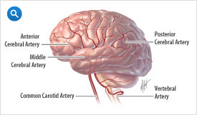
Hemorrhagic Strokes
A Hemorrhagic stroke is caused by bleeding in the brain.
Image used with
Permission of the
Internet Stroke Center

Slide 4
What you will learn about hemorrhagic Strokes
Types of hemorrhagic strokes
Causes
Cerebral aneurysms
Signs and symptoms
Diagnosis
Treatment

Slide 5
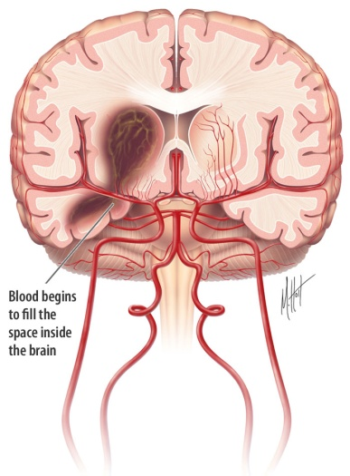
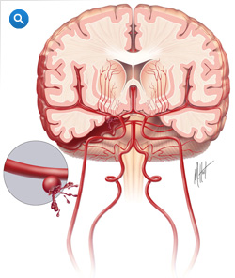
Types of hemorrhagic Strokes
There are two types of hemorrhagic strokes
Intra-axial Hemorrhage
Blood leaking into the brain
Extra-axial Hemorrhage
  Blood leaking into the space just outside of the brain
(Porth, 2008)
Images used with
Permission of the
Internet Stroke Center

Slide 6
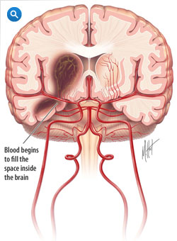
Intra-axial Hemorrhages
Intraparenchymal or intracerebral
Most frequent fatal stroke.
Occurs when a damaged blood vessel in the brain bursts, causing blood to leak into the brain.
The increase in blood, causes
pressure which damages the brain cells
and can cause death.
Usually occurs in the basal ganglia, cerebellum, brain stem or cortex.
(Porth, 2008 and Internet Stroke Center, 2012)
Image used with
Permission of the
Internet Stroke Center

Slide 7
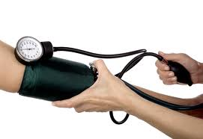
Intra-axial Hemorrhage Causes
Most common cause is Hypertension
Advancing age
Trauma
Erosion of vessels by tumors
Arteriovenous malformations
Blood coagulation disorders
Infections
Drugs
Photo from google images

Slide 8
Quick Question 1
When Sally came into the ER, what significant sign did she have that could lead you to believe that she has a Intracerebral hemorrhage?
Back to case study
Hyperventilation
No, this is not a common cause
Hypertension
Yes! This is a common cause
Fever
No, this is not a common cause

Slide 9

Signs and Symptoms of Intra-axial Hemorrhage strokes
Much the same as ischemic stokes
  Sudden onset, focal and usually one-sided. Determined by the cerebral artery that is affected.
  Severe Headache.
  Sudden numbness or weakness of one side of the face and/or extremities.
  Sudden dysarthia
  Sudden aphasia
    Receptive
    Expressive
    Global
  Sudden visual changes.
  Sudden trouble walking or loss of coordination.
  (Porth, 2008)
  Photo by: The Internet Stroke Center’s
  permission

Slide 10
Question 2
Sally is able to understand what people are saying to her, but when she responds she says the wrong words. She realizes that and becomes very frustrated and angry. What type of disorder is she portraying?
Global Aphasia
This is the combination of Receptive and Expressive aphasia
Receptive Aphasia
Receptive aphasia is the inability to comprehend what people are saying
Expressive Aphasia
Right! Inability to express what she wants to say, but able to understand

Slide 11
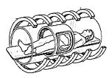
Diagnosis and Treatment of Intra-axial Hemorrhage
Diagnosis
  Based on history and physical exam, brain imaging studies such as CT and MRI’s
Treatment
  Aimed at preventing recurrent bleeds and medical complications
  The risk of recurrence is highest the 1st week after injury
  Recovery is maximized with early and aggressive rehab.
(Porth, 2008)
Image from google images

Slide 12
Question 3
If Sally is found to have a intracerebral hemorrhage she will be started on treatment to prevent further bleeding. Why is it important to prevent recurrent bleeds after diagnosis of a hemorrhagic stoke has been made?
Recurrent stokes always follow initial strokes
Although it is common, recurrent stokes do not always happen
There is no need to prevent recurring strokes
Prevention of recurrent stokes is an essential treatment
Recurrent strokes most often happen the 1st week after initial stoke
Correct! The 1st week after the initial stroke is often the time for recurrent strokes

Slide 13
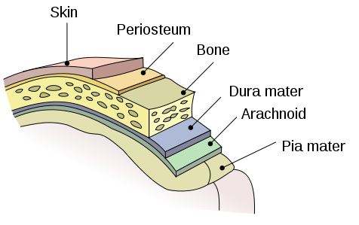
Extra-axial Hemorrhages
Epidural or Subdural hematoma
  Dura mater is the outer most layer of the 3 layer of meninges that surround the brain and spinal cord.
  Subarachnoid hemorrhage
  Arachnoid mater is the middle layer
  of the 3 meniges that surround the
  brain and spinal cord.
  Pia mater is the inner most layer.
  Image from Wikipedia

Slide 14
Epidural Hematoma
Bleeding between dura mater and skull
Causes
Skull fractures
more common in younger people because the membrane covering the brain is not firmly attached as in older people.

Slide 15
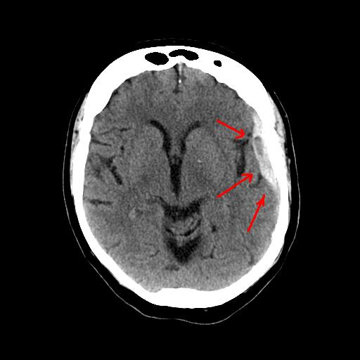
Subdural Hematoma
Bleeding in the subdural space. Veins at surface of the brain and dura stretch and tear, which cause bleeding.
Causes
blood thinning medication,
alcoholism and frequent falls
in elderly.
Picture from Wikipedia with permission

Slide 16
Signs and symptoms of Epidural or Subdural hematomas
Confusion
Drowsiness
Loss of consciousness
Headache
Nausea and/or vomiting

Slide 17
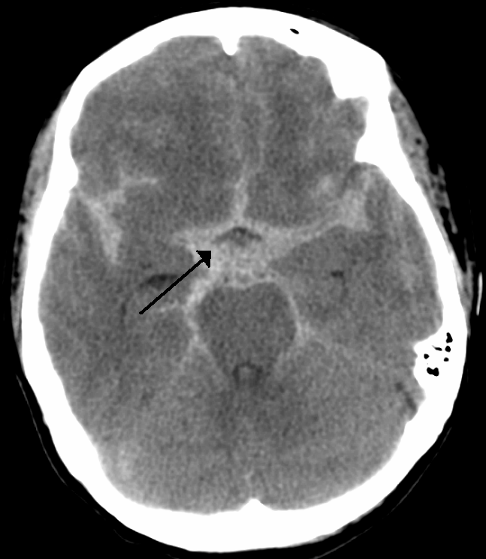
Subarachnoid Hemorrhage
Bleeding in the subarachnoid space, which is the area between the brain and the tissues that cover the brain.
Photo By: Wikipedia with permission from Heilman,
James MD

Slide 18

Subarachnoid Causes
Major cause is by abnormalities of arteries at the base of the brain, which are called cerebral aneurysms.
Thought to arise from congenital defect in the area of the involved blood vessels.
Greater risk of aneurysm with people having polycystic kidney disease, fibro muscular dysplasia, contraction of aorta and arteriovenous malformation of brain.
Other causes are arthrosclerosis, hypertension and bacterial infections.
(Porth, 2008)
Image from The Internet Stoke Center’s
permission

Slide 19
Question 4
After reviewing Sally’s health history, what disease do you suspect could have contributed to her possibly having an aneurysm?
Back to case study
Anxiety
Not a contributing factor to aneurysms
Asthma
Not a contributing factor to aneurysms
Polycystic Kidney disease
Yes this disease causes a higher incidence of an aneurysm

Slide 20
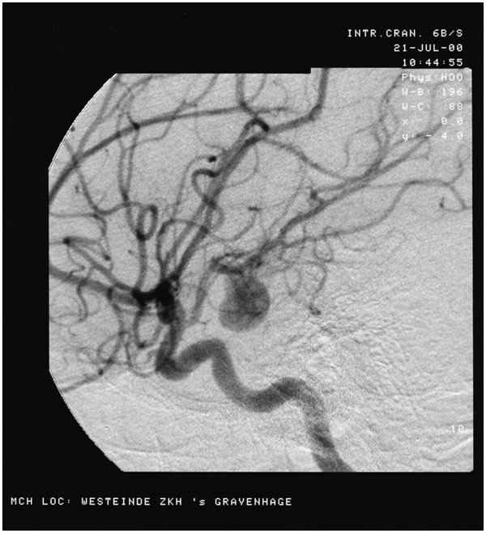
Signs and Symptoms of Subarachnoid Hemorrhage/Cerebral aneurysms
  Divided into 2 phases,
  before and after rupture
  Photo from Wikipedia with permission

Slide 21

Presentation before rupture
Approximately 50% of people with SAH have a history of atypical headache occurring days to weeks before onset. This suggest the presence of a small leak.
The headaches are most
often sudden and accompanied
by nausea, vomiting and dizziness.
(Porth, 2008)

Slide 22
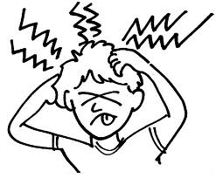
Presentation after rupture
Sudden and severe headache, frequently labeled as the “worst headache of my life”
Sometimes accompanied by loss of consciousness, vomiting, neck stiffness, photophobia (light intolerance), cranial nerve deficits of II, III and IV (diplopia, blurred vision and focal motor and sensory deficits).
Hypertension and cardiac arrhythmias due to massive release of catecholamines.
(Porth, 2008)

Slide 23
Test your knowledge
Question 5
Sally’s blood pressure is 215/106, she has been vomiting, has a stiff neck and is having trouble experiencing diplopia. What could be causing her increased blood pressure if you are suspecting a Subarachnoid hemorrhage?
Massive release of catecholamines
Right! SAH results in a massive release of catecholamine's, causing hypertension
Vomiting
Vomiting does increase BP, but that is not the most contributing factor
Headache from increased cranial pressure
HA does increase BP, but that is not the most contributing factor

Slide 24
Diagnosis of Extra-axial Hemorrhages
  Clinical presentation
  CT scan
  MRI
  lumbar puncture to determine presence of blood in cerebral spinal fluid
  angiography to identify an aneurysm at the source of bleeding which is a definitive diagnostic tool to detect an aneurysm

Slide 25
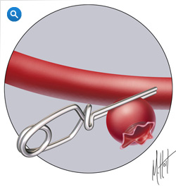
Treatment of Extra-axial Hemorrhages
  Depends on extent of deficit
  Craniotomy within 24 to 72 hours by inserting a clip around the neck of an aneurysm to stop the bleeding and/or removal of a hematoma
  Not a surgery candidate? Then balloon dilation and coiling are considered for aneurysms which is less invasive
  Prevention of vasospasm (focal narrowing of cerebral artery/arteries) usually treated to maintain adequate cerebral pressure by use of vasoactive drugs (such as Nimotop) and/or administration of IVF volume to produce hemodilation.
  Anti seizure medication for prevention
  Aggressive rehab
  (Porth, 2008) Photo by: Internet Stroke
  Center’s permission

Slide 26
Question 6
It is confirmed via MRI that Sally has been diagnosed with a Subarachnoid hemorrhage. What type of drug should Sally be on?
Anti-arrhythmics
Arrhythmias are not a common condition following a SAH
Bronchodilators
Broncho spasms are not a common condition following a SAH
Vasoactives
Yes! Vasospasms are a common condition following SAH

Slide 27
Cushing triad
Can aid in the diagnosis of a hemorrhagic stroke.
Consists of
  Widening pulse pressure (elevated systolic blood pressure and normal or low diastolic blood pressure)
  Irregular respirations
  Bradycardia
  (Emergency medical paramedic, 2012)

Slide 28
Question 7
Sally showed signs of the Cushing triad on
presentation. Which signs did she present with are part of the Cushing triad?
Back to case study
Blood pressure of 214/74
Correct!
Temperature of 99.4
No, this is not a sign in the Cushing triad.
Irregular heart rate
No, bradycardia is a sign but not irregular heart rate.

Slide 29
Lets Review
Hemorrhagic strokes are either intra-axial or Extra-axial
One of the major contributing factors causing hemorrhagic strokes is hypertension
Signs and Symptoms are usually sudden onset most often seen with a severe headache
Diagnosis and Treatment are based off of location, severity and cause

Slide 30
Hemorrhagic Strokes
After workup, Sally was diagnosed with a Subarachnoid hemorrhage from a cerebral aneurysm after MRI confirmation. She was taken to immediate surgery for an aneurysm clipping and evacuation. She is now recovering in the ICU and started on Nimotop to control vasospasms. She remains weak on her right side and continues to have expressive aphasia. She will begin an intensive rehabilitation program to regain some of her independence.

Slide 31
Literature Cited
American Stroke Association (2011, Jan 14). Types of Strokes: Hemorrhagic bleeds. Retrieved from http://www.strokeassociation.org/STROKEORG/AboutStroke/TypesofStroke/HemorrhagicBleeds/Hemorrhagic-Bleeds_UCM_310940_Article.jsp
Continuum Health Partners Centers for Endovascular Surgery (2012). Types of Brain (Cerebral) Aneurysm. Retrieved from http://neuro.wehealny.org/endo/cond_aneurysms.asp
The Internet Stroke Center: an independent web resource for information about care and research (2012). About stroke. Retrieved from http://www.strokecenter.org/patients/about-stroke/what-is-a-stroke/
Porth, C.M. & Matfin, G. (2008). Pathophysiology: Concepts of altered health. Philadelphia: Lippincott, Williams & Wilkins
PubMed Health (2012). Extradural hematoma. Retrieved from http://www.ncbi.nlm.nih.gov/pubmedhealth/PMH0002385/
PubMed Health (2012). Subdural hematoma. Retrieved from http://www.ncbi.nlm.nih.gov/pubmedhealth/PMH0001732/

